Slide 1

Use Genetic Algorithm via MATLAB: Employ the Function
Professor Bo Liu
James Watt School of Engineering

Slide 2
Mathematical benchmark problems
Mathematical benchmark problems are used to test the performance of an algorithm before using it to engineering problems.
  Problems with various characteristics (unimodal, multimodal, many variables, various shape, etc.).
  The global optimum/Pareto front is often known.
  They are often computationally cheap.
  There are reference performances of various algorithms for them in the literature to be compared with.

Slide 3
Mathematical benchmark problems (hyperlinks)
Optimization test problems source 1
Global optimization test problems source 2
Test problems in IEEE Congress on Evolutionary computation 2009

Slide 4
Pros and cons of benchmark problems
Provide a quick evaluation of an algorithm.
Have various shapes and characteristics and have similarity with particular engineering problems.
Often, they are not generated from engineering problems.

Slide 5
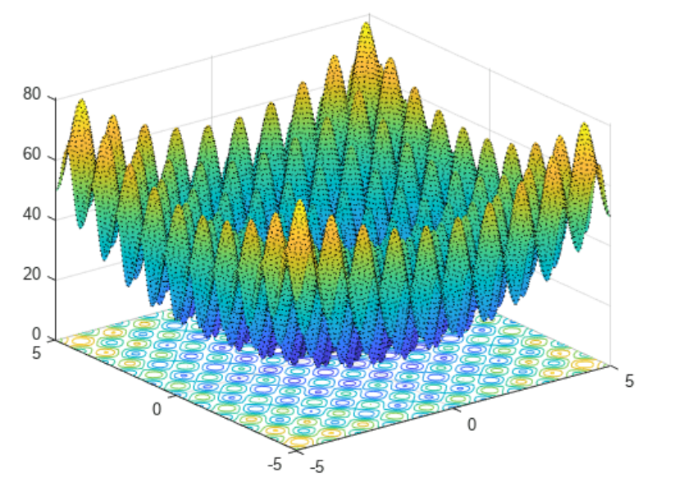
An example benchmark function
An example benchmark function: Rastrigin function​
2D-Rastrigin function

Slide 6
Rastrigin function
where d is the dimension of x.
Description:
many local minimum
one global minimum
Global Minimum: f(x*)=0, x*=[0,…,0]
See live script

Slide 7
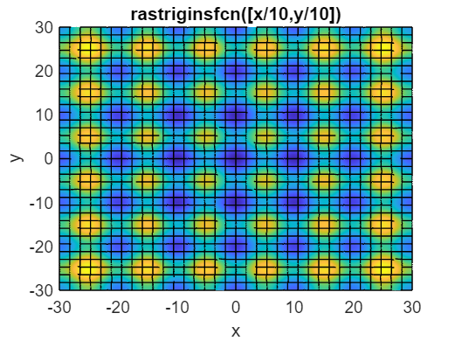

Use GA to solve benchmark problems
rng default % For reproducibility
x = ga(@rastr_fx,2)
This solution ( ) has some distance to the true minimum ( ).
See live script

Slide 8

Use GA to solve benchmark problems
rng default % For reproducibility
x = ga(@rastr_fx,2,[],[],[],[],[-5 -5],[5 5])
This solution ( ) is very near to the true minimum ( ).
See live script

Slide 9
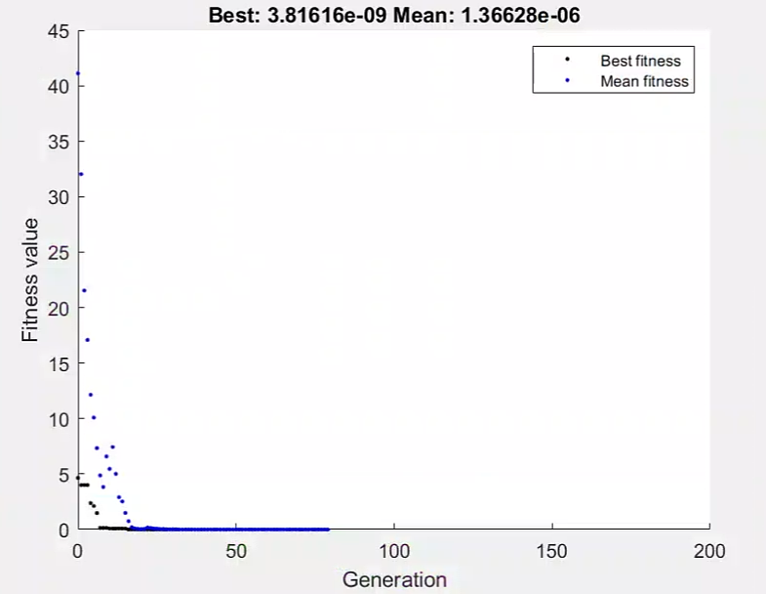
Use GA to solve benchmark problems
rng default % For reproducibility
options = optimoptions('ga','PlotFcn', @gaplotbestf);
x = ga(@rastr_fx,2,[],[],[],[],[-5 -5],[5 5],[],options)
This solution is very near to the true minimum.
See live script

Slide 10

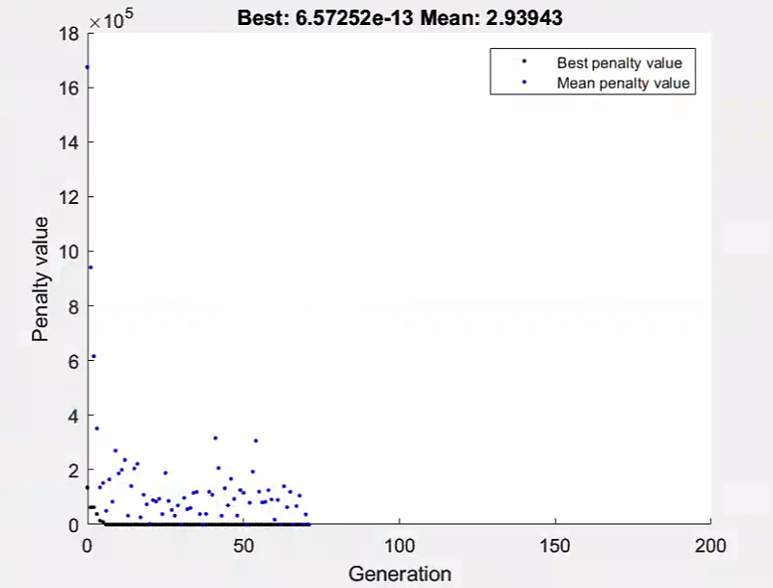
Use GA to solve benchmark problems
rng default % For reproducibility
options = optimoptions('ga','PlotFcn', @gaplotbestf);
x = ga(@rastr_fx,2,[],[],[],[],[-5 -5],[1500 1500],[],[1],options)
This solution is very near to the true minimum.
See live script

Slide 11
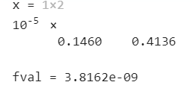
Use GA to solve benchmark problems
rng default % For reproducibility
options = optimoptions('ga','PlotFcn', @gaplotbestf);
[x fval]= ga(@rastr_fx,2,[],[],[],[],[-5 -5],[5 5],[],options)
This solution is very near to the true minimum.
See live script

Slide 12




Thanks!
#UofGWorldChangers
@UofGlasgow

